Slide 1

Predicting Commodity Prices Using Time Series Analysis
Group 4:
1. Piyush Sunil Borse 25PGAI0026
2. Prateek Majumder 25PGAI0027
3. Bhawana Thawarani 25PGAI0137
4. Prajwal Wagh 25PGAI0109
5. Yuvraj Singh Srinet 25PGAI0019

Slide 2
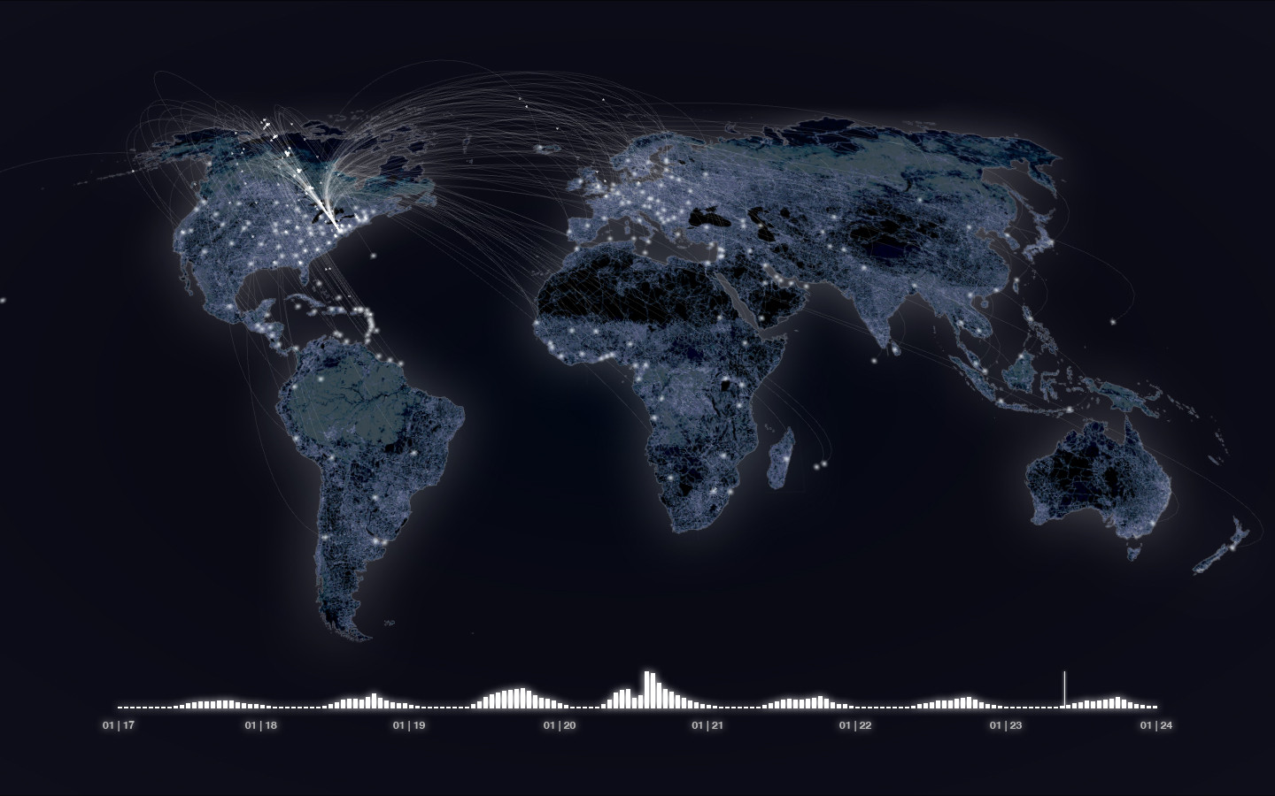
Problem Statement
The objective of this project is to develop a robust time series model that can predict future prices of key global commodities.
This prediction model will leverage historical price data, to forecast future price movements.
In our implementation, we have predicted Fuel Price Index.
T.
ThePhoto by PhotoAuthor is licensed under CCYYSA.

Slide 3
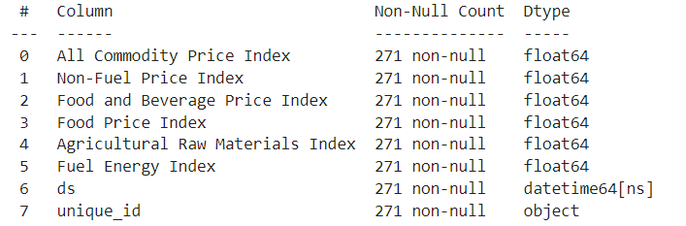
DATASET
We got our dataset from Kaggle.
The dataset includes monthly prices and indexes for 53 commodities from 1992 to 2014, with 2005 as the reference year for indexes (value = 100). Key categories in the dataset include All Commodity, Food and Beverage, Food, Beverage and Fuel Energy. Each category is represented by its respective price index.
ThePhoto by PhotoAuthor is licensed under CCYYSA.

Slide 4
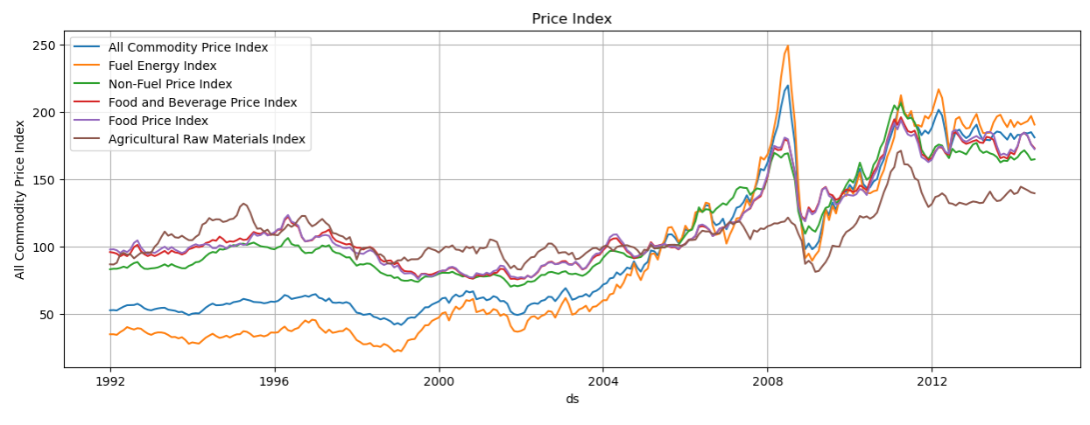
Data Analysis

Slide 5


Dip in Data after 2008

Slide 6
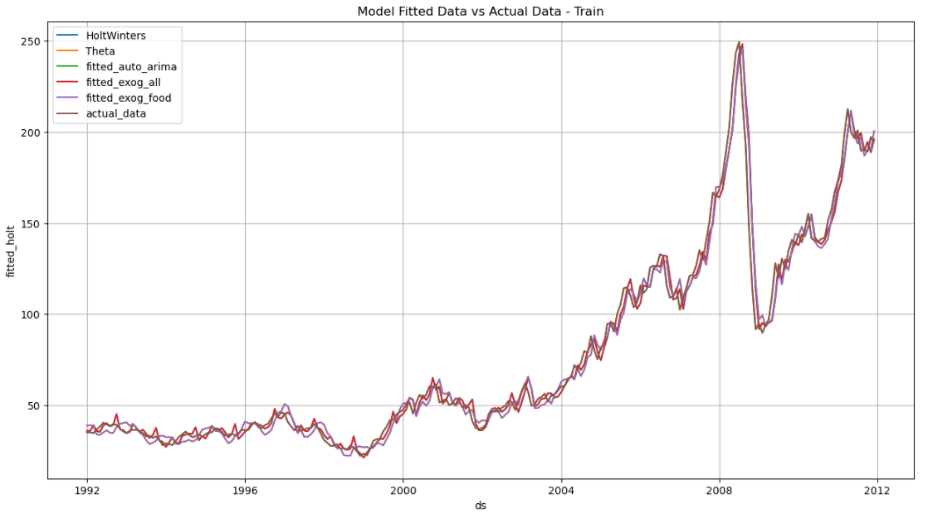
Time Series Modeling
ThePhoto by PhotoAuthor is licensed under CCYYSA.

Slide 7
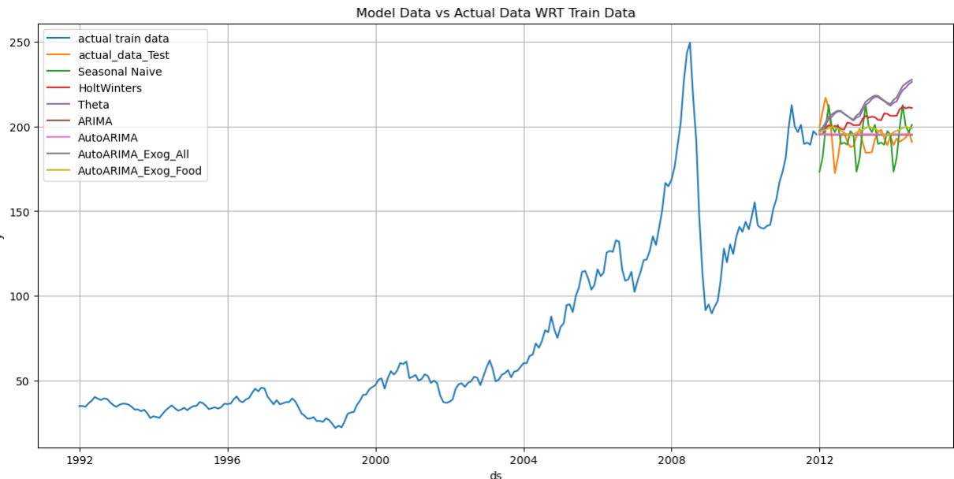
Time Series Forecasting
Seasonal Naïve
HoltWinters
Theta
ARIMA
AutoARIMA
AutoARIMA with
Exogenous Variables
ThePhoto by PhotoAuthor is licensed under CCYYSA.

Slide 8
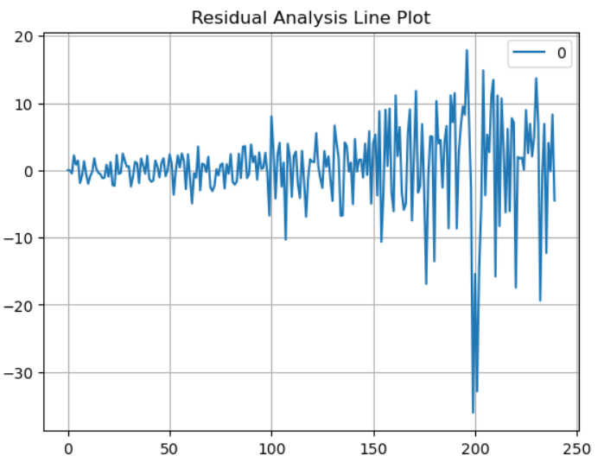
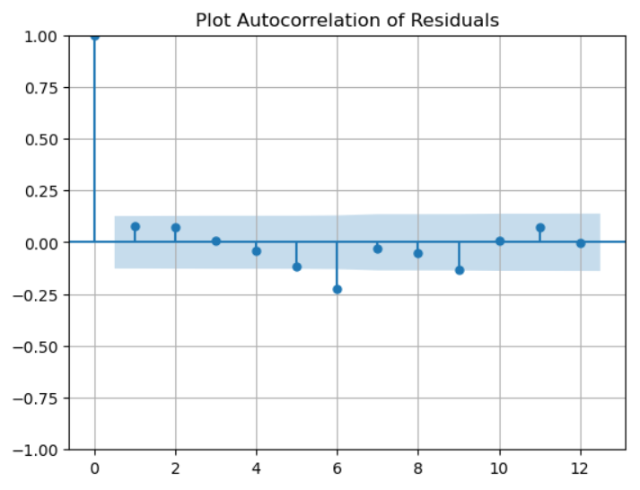
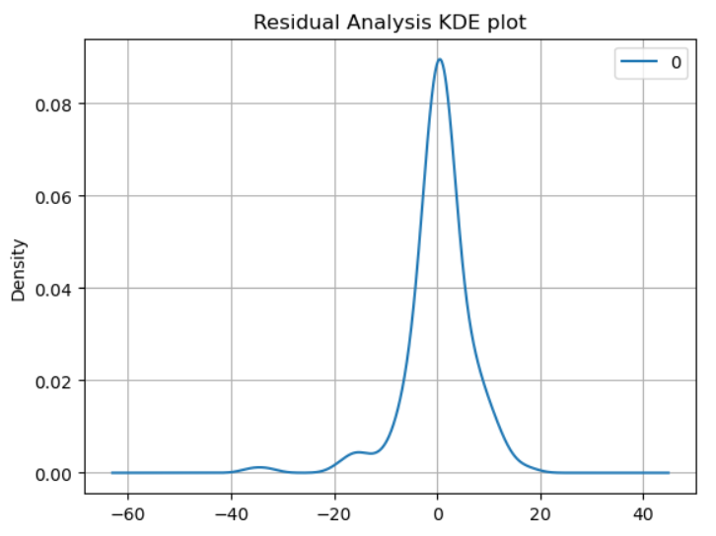
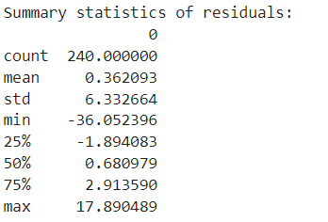
Residual Diagnostics
AUTO ARIMA:
ThePhoto by PhotoAuthor is licensed under CCYYSA.

Slide 9
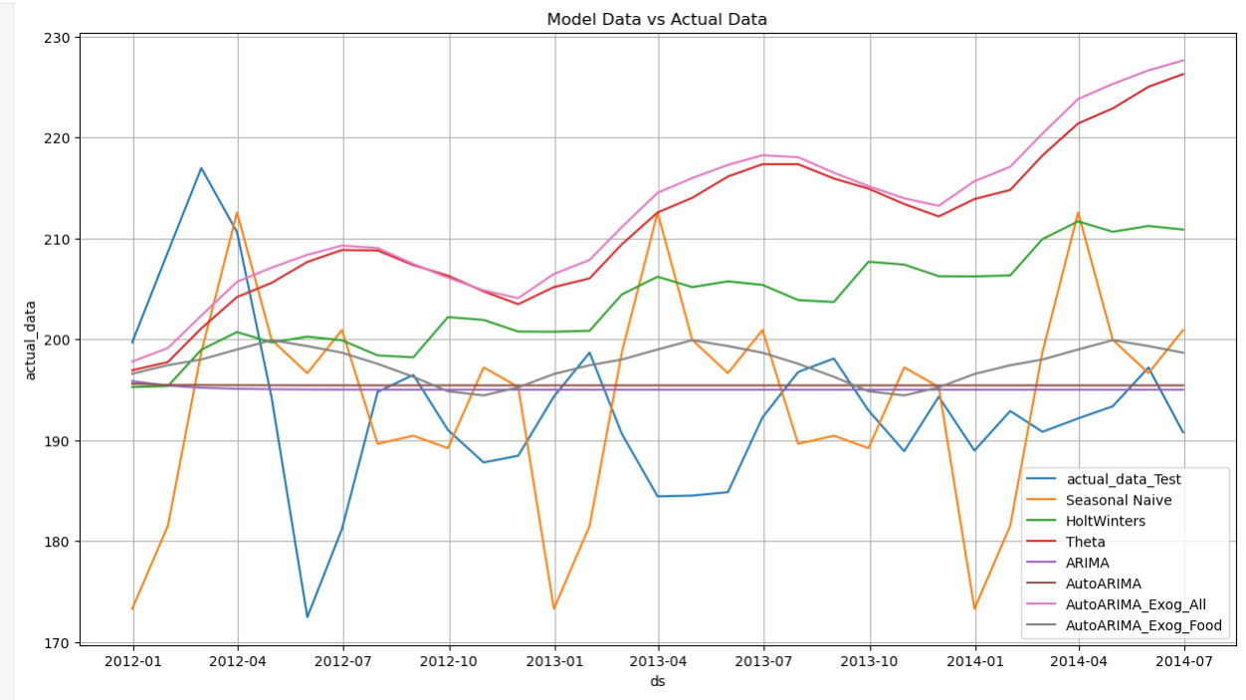
Results:
AUTO ARIMA:
ThePhoto by PhotoAuthor is licensed under CCYYSA.

Slide 10

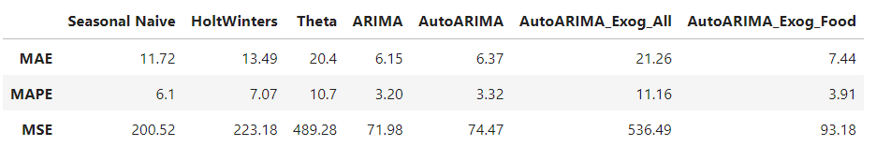
Error Reporting:
The ARIMA model outperforms other models in terms of MAE (6.15), MAPE (3.20), and MSE (71.98). This indicates that ARIMA provides the most accurate forecasts among the models compared.
The AutoARIMA model that includes only food-related exogenous variables (AutoARIMA_Exog_Food) also performs well, especially in terms of MAPE (3.91) and MAE (7.44). Its performance is better than the basic AutoARIMA model but not as good as the basic ARIMA model.

Slide 11

Limitations of the Chosen Dataset and Models
The dataset used includes some exogenous variables, but the selection might not be comprehensive.
Models like ARIMA and AutoARIMA assume linear relationships and might not capture complex nonlinear patterns in the data.
There's a risk that models, especially more complex ones like AutoARIMA with multiple exogenous variables, might overfit to the training data, thus performing poorly on unseen data.
While models like Holt-Winters and ARIMA can capture seasonality and trend, they may not be sufficient for datasets with more complex seasonal patterns or multiple seasonal cycles.

Slide 12

Potential Areas for Improvement or Further Analysis
Incorporate More Relevant Exogenous Variables.
Updating the dataset to include more recent data can help capture current trends and improve model robustness.
Employ more advanced models like Long Short-Term Memory (LSTM) networks, Prophet by Facebook, or other deep learning techniques that can capture complex nonlinear relationships and multiple seasonalities.

Slide 13
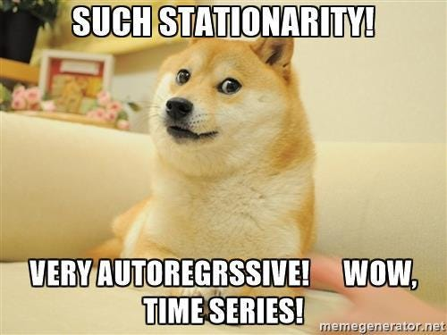
Thank You

